Slide 1


Noida Institute of Engineering and Technology, Greater Noida
Text Classification and NLP Applications
Unit: 4
Natural Language Processing
Subject Code: ACSAI0712
Mr. M. Abdul Mateen Siddiqui
(Assistant Professor)
Department of CSE (Cyber Security)
Course Details B. Tech. VII Sem

Slide 2
Faculty Introduction
Name : Mr. M. Abdul Mateen Siddiqui
Qualification: B. Tech (CSE), M. Tech (CSE-CFIS), Ph. D (Pursuing)
Area of Specialization: Cyber Forensics, Information Security, Digital Forensics, Smart Wearable Devices and IoT Devices

Slide 3
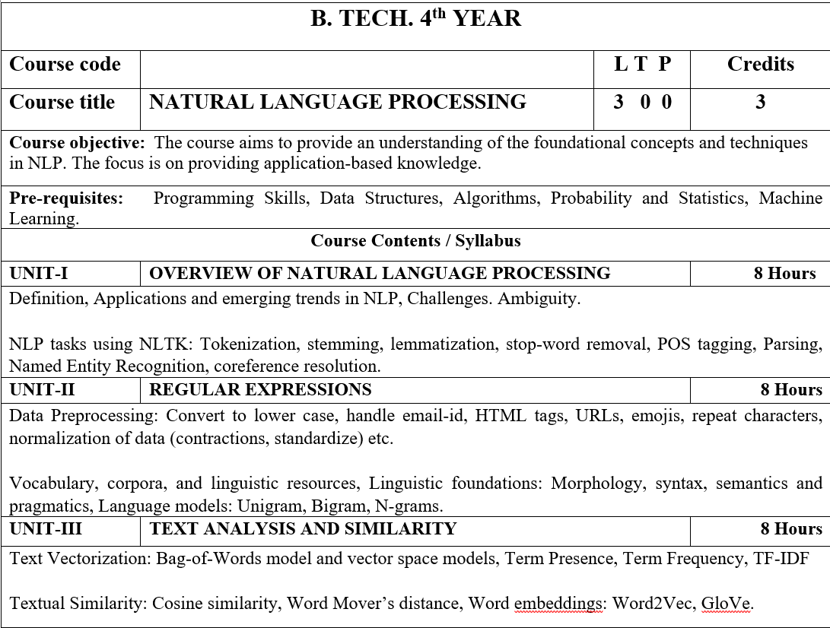
Syllabus

Slide 4
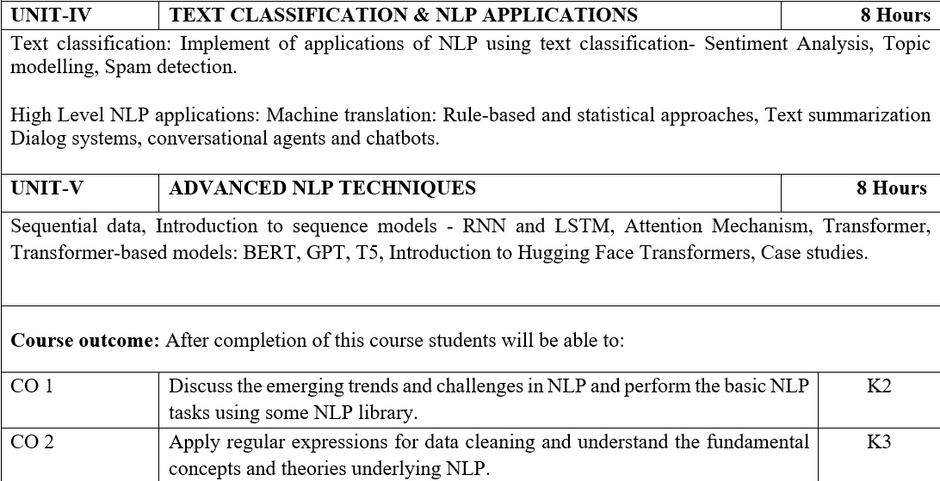
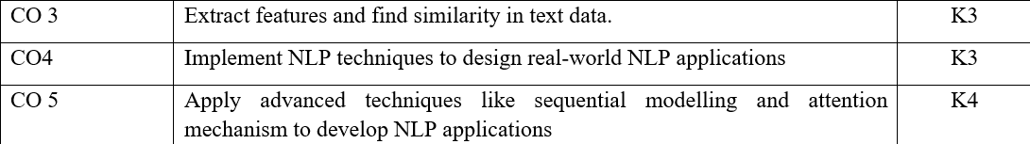
Syllabus

Slide 5
Video Links
https://realpython.com/nltk-nlp-python/
https://www.coursera.org/lecture/python-text-mining/basic-nlp-tasks-with-nltk-KD8uN
https://www.coursera.org/lecture/nlp-sequence-models/learning-word-embeddings-APM5s
https://www.coursera.org/projects/regular-expressions-in-python
https://www.coursera.org/learn/python-text-mining/lecture/sVe8B/regular-expressions

Slide 6
Course Objective
The course aims to provide an understanding of the foundational concepts and techniques in NLP.
The focus is on providing application-based knowledge.

Slide 7
Course Outcome
CO1 | Discuss the emerging trends and challenges in NLP and perform the basic NLP tasks using some NLP library. | K2
CO2 | Apply regular expressions for data cleaning and understand the fundamental concepts and theories underlying NLP. | K3
CO3 | Extract features and find similarity in text data. | K3
CO4 | Implement NLP techniques to design real-world NLP applications | K3
CO5 | Apply advanced techniques like sequential modelling and attention mechanism to develop NLP applications | K4

Slide 8
Program Outcome
1. Engineering knowledge: Apply the knowledge of mathematics, science, engineering fundamentals, and an engineering specialization for the solution of complex engineering problems.
2. Problem analysis: Identify, formulate, research literature, and analyze complex engineering problems reaching substantiated conclusions using first principles of mathematics, natural sciences, and engineering sciences.
3. Design/development of solutions: Design solutions for complex engineering problems and design system components or processes that meet the specified needs with appropriate consideration for public health and safety, and cultural, societal, and environmental considerations.

Slide 9
Program Outcome
4. Conduct investigations of complex problems: Use research based knowledge and research methods including design of experiments, analysis and interpretation of data, and synthesis of information to provide valid conclusions.
5. Modern tool usage: Create, select, and apply appropriate techniques, resources, and modern engineering and IT tools, including prediction and modeling to complex engineering activities, with an understanding of the limitations.
6. The engineer and society: Apply reasoning informed by the contextual knowledge to assess societal, health, safety, legal and cultural issues and the consequent responsibilities relevant to the professional engineering practice.

Slide 10
Program Outcome
7. Environment and sustainability: Understand the impact of the professional engineering solutions in societal and environmental contexts, and demonstrate the knowledge of, and need for sustainable development.
8. Ethics: Apply ethical principles and commit to professional ethics and responsibilities and norms of the engineering practice.
9. Individual and team work: Function effectively as an individual, and as a member or leader in diverse teams, and in multidisciplinary settings.

Slide 11
Program Outcome
10. Communication: Communicate effectively on complex engineering activities with the engineering community and with the society at large, such as, being able to comprehend and write effective reports and design documentation, make effective presentations, and give and receive clear instructions.
11. Project management and finance: Demonstrate knowledge and understanding of the engineering and management principles and apply these to one’s own work, as a member and leader in a team, to manage projects and in multidisciplinary environments.
12.Life-long learning: Recognize the need for, and have the preparation and ability to engage in independent and life-long learning in the broadest context of technological change.

Slide 12
Pre-requisites
Programming Skills,
Data Structures,
Algorithms,
Probability and Statistics,
Machine Learning.

Slide 13
Unit-4:Content
TEXT CLASSIFICATION & NLP APPLICATIONS:
Text Classification:
Implement of applications of NLP using text classification
Sentiment Analysis
Topic Modelling
Spam Detection
High Level NLP Applications:
Machine Translation
Rule-based and statistical approaches
Text Summarization Dialog Systems
Conversational Agents and Chatbots

Slide 14
What is Text Classification & NLP Applications?
Text classification in Natural Language Processing (NLP) is the process of assigning predefined categories or labels to text documents based on their content.
The goal of text classification is to automatically categorize and organize large volumes of text data into relevant classes or categories.
Text classification is essential in various NLP applications, where the goal is to automatically organize, categorize, or make predictions about text data.
Text classification techniques typically involve machine learning models, such as Naive Bayes, Support Vector Machines (SVM), or deep learning models like Convolutional Neural Networks (CNNs) and Recurrent Neural Networks (RNNs).
These models are trained on labeled data, and their performance is evaluated using metrics like accuracy etc.

Slide 15
Text Classification involves the following steps:
Data Preparation: Gathering and preprocessing the text data, which may include tasks like cleaning, tokenization, removing stopwords, and stemming or lemmatization.
Feature Extraction: Converting text data into numerical features that machine learning models can understand. Common techniques include TF-IDF (Term Frequency-Inverse Document Frequency) and word embeddings.
Labeling: Assigning labels or categories to the training data. This data should include examples of text documents with known categories.
Model Deployment: Once a text classification model performs well on test data, it can be deployed to make predictions on new, unlabeled text documents.
Model Training: Using machine learning algorithms or deep learning models to train a classifier on the labeled training data. Common algorithms used for text classification include Naive Bayes, Support Vector Machines (SVM), and deep learning architectures like Convolutional Neural Networks (CNNs) and Recurrent Neural Networks (RNNs).
Model Evaluation: Assessing the performance of the text classifier on a separate set of labeled test data. Common evaluation metrics include accuracy, precision, recall, F1 score, and confusion matrices.

Slide 16
Some common NLP applications that heavily rely on text classification:
Sentiment Analysis: Sentiment analysis, also known as opinion mining, involves classifying text documents, such as product reviews or social media posts, into categories representing sentiment, such as positive, negative, or neutral. It is widely used for understanding public opinion and customer feedback.
Language Identification: Language identification is the process of determining the language of a text document, which is essential for handling multilingual content and routing it to the appropriate processing pipelines.
Topic Classification: Topic classification categorizes text documents into predefined topics or themes. It is used for organizing news articles, blog posts, or research papers into specific categories, making it easier to access relevant content.
Spam Detection: Spam detection involves classifying emails or messages as spam (unwanted or malicious content) or not. It is a common application in email filtering and online communication platforms.
Intent Recognition: In chatbots and virtual assistants, text classification is used to identify the intent behind user queries or requests. For example, understanding whether a user is asking for weather information, making a restaurant reservation, or seeking customer support.
Document Categorization: Document categorization is the classification of documents into predefined classes or categories based on their content. It is commonly used in legal, scientific, and administrative domains to organize and retrieve documents efficiently.

Slide 17
Some common NLP applications that heavily rely on text classification:
Document Routing: In customer support or document management systems, text classification is used to route incoming documents to the appropriate department or team for handling.
Medical Text Classification: In healthcare, text classification can be used to categorize medical records, radiology reports, or clinical notes into relevant categories, assisting healthcare professionals in data management and decision-making.
News Classification: News articles are classified into sections or topics like politics, sports, entertainment, or technology. This categorization helps news organizations and readers locate relevant stories.
Toxic Comment Detection: In online communities and social media, text classification is used to identify and moderate toxic or abusive comments or posts.
Content Recommendation: Recommender systems use text classification to understand user preferences and recommend relevant content, such as news articles, movies, products, or books.

Slide 18
Implement of applications of NLP using Text Classification - Sentiment Analysis
Implementing an application of NLP using text classification for sentiment analysis typically involves several steps, from data preprocessing to model development and deployment. Below is a high-level overview of how you can create a sentiment analysis application:
1. Data Collection: Gather a dataset of text documents for sentiment analysis. This dataset should be labeled with sentiment labels, such as positive, negative, or neutral, to serve as the ground truth for training the model.
2. Data Preprocessing:
- Text Cleaning: Remove any noise from the text data, including special characters, numbers, and HTML tags.
- Tokenization: Split the text into individual words or tokens.
- Lowercasing: Convert all text to lowercase for consistency.
- Stopword Removal: Eliminate common stopwords (e.g., "the," "and") that may not carry significant sentiment information.
- Lemmatization or Stemming: Reduce words to their base form (lemmas) or stems to further normalize the text.
3. Feature Extraction:
- Use a method like TF-IDF (Term Frequency-Inverse Document Frequency) to convert text into numerical feature vectors.
- Alternatively, consider using pre-trained word embeddings, such as Word2Vec or GloVe, to capture the semantic meaning of words.
4. Model Selection:
- Choose a machine learning model for text classification. Common options include logistic regression, Naive Bayes, Support Vector Machines (SVM), and deep learning models like Convolutional Neural Networks (CNNs) or Recurrent Neural Networks (RNNs).
5. Model Training:
- Split your dataset into a training set and a validation set for model training and evaluation.
- Train the selected model on the training data and fine-tune its hyperparameters.

Slide 19
Implement of applications of NLP using Text Classification - Sentiment Analysis
6. Model Evaluation:
- Assess the model's performance using metrics like accuracy, precision, recall, F1 score, and confusion matrices.
- Make sure to evaluate the model on the validation set to gauge its generalization capabilities.
7. Hyperparameter Tuning:
- Experiment with different hyperparameters to optimize the model's performance.
- Techniques like grid search or random search can be used to find the best combination of hyperparameters.
8. Model Deployment:
- Once you are satisfied with your model's performance, deploy it to a production environment.
- You can use web frameworks (e.g., Flask or Django) to create a web application or API for sentiment analysis.
9. User Interface:
- Create a user-friendly interface to interact with your sentiment analysis model. This could be a web application, mobile app, or command-line tool.
10. Inference:
- Users input text, and your application sends the text to the deployed model for sentiment analysis.
- The model predicts the sentiment of the input text (positive, negative, or neutral).
11. Display Results:
- Present the sentiment analysis results to users through the user interface or API.
12. Monitoring and Maintenance:
- Continuously monitor your model's performance in the production environment.
- Periodically retrain the model with updated data to keep it accurate over time.

Slide 20
Implement of applications of NLP using Text Classification – Topic Modelling
Implementing an application of NLP using text classification for topic modeling involves a process of identifying and categorizing the main topics or themes within a collection of text documents. One common method for topic modeling is Latent Dirichlet Allocation (LDA). Here's a step-by-step guide on how to build a topic modeling application using LDA:
1. Data Collection:
- Gather a dataset of text documents where you want to discover and categorize topics. This dataset can be articles, research papers, news documents, or any other collection of text.
2. Data Preprocessing:
- Clean and preprocess the text data, which may include removing punctuation, special characters, and numbers.
- Tokenize the text into individual words or phrases.
- Convert all text to lowercase for consistency.
- Remove stopwords (common words that do not carry significant meaning).
- Optionally, perform lemmatization or stemming to reduce words to their base forms.
3. Text Vectorization:
- Use a technique like TF-IDF (Term Frequency-Inverse Document Frequency) or Count Vectorization to convert the text data into numerical feature vectors. These vectors represent the frequency of words in the documents.
- Set the number of features (words or phrases) to consider.
4. LDA Model Training:
- Choose the number of topics you want to discover in your data. This is a hyperparameter for the LDA model.
- Train the LDA model on the vectorized text data. You can use libraries like Gensim or Scikit-Learn, which provide LDA implementations.
- The LDA model will assign each word in the dataset to a specific topic, and each document will have a distribution of topics.

Slide 21
Implement of applications of NLP using Text Classification – Topic Modelling
5. Model Evaluation:
- Although LDA is unsupervised and doesn't have traditional evaluation metrics, you can assess the quality of topics by:
- Examining the words associated with each topic.
- Reviewing the coherence of topics, ensuring that they make sense.
- Checking how well documents are represented by their assigned topics.
6. Visualization:
- Visualize the results using techniques like word clouds to show prominent words in each topic.
- Generate topic-document distributions and visualize them.
7. Inference:
- Once the LDA model is trained, you can use it to infer topics for new documents. These documents can be text snippets or entire documents.
8. Application Deployment:
- Develop a web application or API for topic modeling that allows users to input text and receive topic results.
- Make the application user-friendly with a clean interface.
9. User Interaction:
- Users input text data into the application.
- The application uses the trained LDA model to classify the text into topics.
10. Display Results:
- Present the topics identified in the text data to users, along with their respective keywords and the proportion of each topic in the document.
11. Monitoring and Maintenance:
- Continuously monitor the model's performance and retrain it with updated data if necessary.
- Ensure that topics remain relevant and meaningful as the data evolves.

Slide 22
Implement of applications of NLP using Text Classification – Spam Detection
Implementing an NLP application for spam detection involves building a system that can automatically identify and filter out unwanted or malicious content from incoming messages, such as emails or text messages. Here's a step-by-step guide on how to create a spam detection application:
1. Data Collection:
- Gather a dataset of labeled messages, which includes both spam and non-spam (ham) examples. These messages will serve as the training data for your spam detection model.
2. Data Preprocessing:
- Clean and preprocess the text data, which may involve removing punctuation, special characters, and numbers.
- Tokenize the text into individual words or phrases.
- Convert all text to lowercase for consistency.
- Remove stopwords (common words that do not carry significant meaning).
- Optionally, perform lemmatization or stemming to reduce words to their base forms.
3. Feature Extraction:
- Use a technique like TF-IDF (Term Frequency-Inverse Document Frequency) or Count Vectorization to convert the text data into numerical feature vectors. These vectors represent the frequency of words in the messages.
4. Model Selection:
- Choose a machine learning model for text classification. Common options include logistic regression, Naive Bayes, Support Vector Machines (SVM), and deep learning models like Convolutional Neural Networks (CNNs) or Recurrent Neural Networks (RNNs).
5. Model Training:
- Split your dataset into a training set and a validation set for model training and evaluation.
- Train the selected model on the training data and fine-tune its hyperparameters.

Slide 23
Implement of applications of NLP using Text Classification – Spam Detection
6. Model Evaluation:
- Assess the model's performance using metrics like accuracy, precision, recall, F1 score, and confusion matrices.
- Make sure to evaluate the model on the validation set to gauge its generalization capabilities.
7. Hyperparameter Tuning:
- Experiment with different hyperparameters to optimize the model's performance.
- Techniques like grid search or random search can be used to find the best combination of hyperparameters.
8. Model Deployment:
- Deploy the spam detection model to a production environment.
- Create an API or integrate the model into an email server or messaging platform.
9. User Interaction:
- Users receive incoming messages, and the spam detection model automatically evaluates each message.
10. Spam Detection:
- The model classifies each message as either spam or non-spam based on its content.
11. Filtering:
- Spam messages are filtered out and sent to a designated spam folder or flagged as spam.
- Non-spam messages are delivered to the recipient's inbox.
12. Monitoring and Maintenance:
- Continuously monitor the model's performance in the production environment.
- Periodically retrain the model with updated data to adapt to evolving spamming techniques.

Slide 24
What is High Level NLP Applications?
High-level NLP applications refer to complex and sophisticated natural language processing (NLP) tasks that go beyond basic text processing and analysis.
These applications involve the use of advanced techniques, models, and algorithms to understand, generate, or manipulate human language in more nuanced and context-aware ways.
These high-level NLP applications leverage state-of-the-art models, extensive training data, and advanced algorithms to perform complex language-related tasks.
They are at the forefront of NLP research and are increasingly integrated into real-world applications to enhance human-computer interaction and improve decision-making.

Slide 25
Here are Some High-Level NLP Applications:
7. Text Classification for Content Recommendations: Sophisticated text classification models are used in content recommendation systems, offering personalized recommendations to users based on their interests and behavior.
4. Text Generation: Text generation models, like OpenAI's GPT-3, can produce coherent and contextually relevant text, making them valuable for content generation, storytelling, and chatbot responses.
1. Machine Translation: Machine translation systems, like Google Translate, automatically translate text or speech from one language to another. These systems employ neural machine translation models and large multilingual datasets to provide accurate translations.
3. Text Summarization: Text summarization algorithms generate concise and coherent summaries of longer documents, helping users quickly grasp the main points of a text. Abstractive and extractive summarization methods are used in this context.
6. Named Entity Recognition (NER): Advanced NER models can identify and categorize specific entities in text, such as names of people, organizations, locations, and more. They are used in information extraction and knowledge graph construction.
2. Question Answering: Question-answering systems, such as chatbots or virtual assistants, answer user questions by extracting relevant information from text documents or structured data. These systems often use techniques like text comprehension and knowledge retrieval.
5. Sentiment Analysis: Beyond basic sentiment classification, high-level sentiment analysis can assess fine-grained sentiment, emotions, and subjectivity in text, making it useful in market research and brand sentiment analysis.

Slide 26
Here are Some High-Level NLP Applications:
15. Text-based Emotion Detection: These applications detect and analyze the emotional tone or sentiment in text, helping businesses understand customer emotions and feedback.
10. Semantic Search: Semantic search engines go beyond simple keyword matching and take into account the semantic meaning of words and phrases to provide more relevant search results.
8. Dialogue Systems: Dialogue systems, including chatbots and virtual assistants, engage in conversational interactions with users. They use natural language understanding and generation to respond appropriately to user queries.
14. Speech Recognition: Advanced speech recognition models can transcribe spoken language into text with high accuracy, enabling applications like voice assistants and transcription services.
9. Language Modeling: Advanced language models, such as GPT-4, are trained on massive text corpora and are capable of generating human-like text in a wide range of languages and styles. They are used for content generation, creative writing, and more.
11. Document Classification: Beyond basic text classification, high-level document classification systems can categorize and organize large volumes of documents into complex taxonomies or hierarchical structures.
12. Image Captioning: Combining computer vision with NLP, image captioning generates natural language descriptions for images or videos. These systems use both image analysis and language generation.
13. Text-to-Speech (TTS): Advanced TTS systems use neural networks to convert text into human-like speech, making them useful in applications like virtual assistants and audiobook narration.

Slide 27
What is Machine Translation?
Machine translation is a high-level natural language processing (NLP) application that involves the automatic translation of text or speech from one language to another.
It plays a crucial role in bridging language barriers, facilitating cross-cultural communication, and making multilingual content accessible to a global audience.
Machine translation is a powerful and evolving NLP application that continues to improve with advances in deep learning and access to more multilingual data.
It has wide-ranging applications in business, international communication, content localization, and global accessibility, enabling people to communicate across language barriers with greater ease.
Machine Translation, the process of automatically translating text or speech from one language to another, has traditionally been approached using two main techniques: Rule-Based Machine Translation (RBMT) and Statistical Machine Translation (SMT).

Slide 28
What is Rule – Based Machine Translation (RBMT)?
1. Principles: Rule-based machine translation is based on linguistic and grammatical rules. It relies on a set of predefined linguistic rules, dictionaries, and linguistic resources to translate text. These rules are typically handcrafted by linguists and language experts.
2. Workflow: RBMT systems analyze the source text, break it down into syntactic and semantic components, and generate an interlingua (an intermediate representation of the text). Then, the interlingua is used to generate the target language output.
3. Linguistic Rules: RBMT systems use linguistic rules that include grammar, syntax, and morphology to transform the source language into the target language. These rules may cover word order, verb conjugations, noun declensions, and more.
4. Pros:
- RBMT systems can be highly accurate in cases where the linguistic rules are well-defined.
- They can handle languages with complex grammatical structures.
5. Cons:
- Developing and maintaining linguistic rules is a labor-intensive and time-consuming process.
- RBMT systems may struggle with idiomatic expressions, irregular verbs, or languages with limited linguistic resources.
- They may not adapt well to variations in language and context.

Slide 29
What is Statistical Machine Translation (SMT)?
1. Principles: Statistical machine translation is based on statistical models and large parallel corpora, which are collections of text in two or more languages. Instead of relying on linguistic rules, SMT systems learn translation patterns from data.
2. Workflow: SMT models use alignment models to determine the likelihood of words and phrases in the source language being translated into words and phrases in the target language. The translation decision is probabilistic and based on observed data.
3. Parallel Corpora: SMT systems require parallel corpora, which are texts in the source and target languages that are translations of each other. The more extensive and diverse the parallel data, the better the SMT model's performance.
4. Pros:
- SMT systems are data-driven, making them more adaptable to different languages and domains.
- They can automatically learn translation patterns from large datasets, reducing the need for manual rule creation.
- SMT can handle idiomatic expressions and colloquial language effectively.
5. Cons:
- SMT models may have challenges with languages with limited parallel data.
- They can generate translations that lack fluency and coherence, especially for languages with significant grammatical differences from the source language.

Slide 30
What is Text Summarization?
Definition: Text summarization is the process of creating concise and coherent summaries of longer documents while retaining the most important information and main ideas. It aims to provide a shorter version of a text that captures its essence.
Types:
- Extractive Summarization: Extractive summarization methods select sentences or passages directly from the source document to form the summary. These sentences are often the most representative and important parts of the text.
- Abstractive Summarization: Abstractive summarization methods generate novel sentences to summarize the content. This involves paraphrasing and rephrasing the source text to create a coherent and human-like summary.
Use Cases:
- Information Retrieval: Summarizing search results or lengthy articles to help users quickly understand the content and decide if it's relevant.
- Document Summarization: Creating executive summaries for long reports, research papers, legal documents, or books.
- Content Recommendation: Summarizing news articles or blog posts to provide users with short previews and help them choose what to read.
- Educational Tools: Creating concise study materials from textbooks or research papers to assist students in understanding complex subjects.
Techniques:
- Text summarization techniques include traditional methods like TF-IDF (Term Frequency-Inverse Document Frequency) and graph-based algorithms.
- Deep learning approaches, such as encoder-decoder models, are increasingly used for abstractive summarization.

Slide 31
What is Dialog Systems?
Definition: Dialog systems, also known as conversational agents or chatbots, engage in natural language conversations with users. They can answer questions, provide information, and assist with various tasks through text or voice-based interactions.
Types:
- Rule-Based Dialog Systems: These systems follow predefined rules and scripts to guide interactions. They have a structured decision-tree-like approach to conversation.
- Data-Driven Dialog Systems: Data-driven chatbots use machine learning techniques, such as deep learning and reinforcement learning, to understand user inputs and generate human-like responses. They can learn from large datasets of human interactions.
Use Cases:
- Customer Support: Chatbots provide 24/7 customer support on websites, answering frequently asked questions and assisting with common issues.
- Virtual Assistants: Voice-activated virtual assistants like Siri, Google Assistant, and Alexa engage in conversations to perform tasks and answer questions.

Slide 32
What is Dialog Systems?
- Healthcare: Virtual health assistants help patients with medical queries, schedule appointments, and provide health information.
- Information Retrieval: Chatbots assist users in finding information, booking services, making reservations, and retrieving personalized data.
- Entertainment: Dialog systems are used in interactive storytelling, gaming, and as virtual companions.
Techniques:
- Dialog systems employ natural language understanding (NLU) to comprehend user inputs and natural language generation (NLG) to produce human-like responses.
- Reinforcement learning and reinforcement learning from human feedback (RLHF) are used for training data-driven dialog systems.

Slide 33
What is Conversational Agents & Chatbots?
Definition: Conversational agents, also known as chatbots, are software programs or virtual assistants that use natural language understanding (NLU) and natural language generation (NLG) to interact with users through text or voice-based conversations. They can answer questions, provide information, assist with tasks, and facilitate various interactions.
Types:
- Rule-Based Chatbots: Rule-based chatbots follow predefined scripts and rules to guide interactions. They typically have a structured decision-tree-like approach to conversation.
- Data-Driven Chatbots: Data-driven chatbots use machine learning techniques, such as deep learning and reinforcement learning, to understand user inputs and generate human-like responses. They learn from large datasets of human interactions.
- Virtual Assistants: Virtual assistants are a subtype of chatbots that assist users in tasks, such as setting reminders, sending messages, and providing information, through voice interactions.
Use Cases:
- Customer Support: Chatbots provide 24/7 customer support on websites, answering frequently asked questions and assisting with common issues. They can escalate complex queries to human agents when needed.

Slide 34
What is Conversational Agents & Chatbots?
- Virtual Assistants: Voice-activated virtual assistants like Siri, Google Assistant, and Alexa engage in conversations to perform tasks and answer questions. They can control smart devices and provide voice search functionality.
- Healthcare: Virtual health assistants help patients with medical queries, schedule appointments, and provide health information. They can offer medication reminders and symptom tracking.
- Information Retrieval: Chatbots assist users in finding information, booking services, making reservations, and retrieving personalized data. They are used in search engines and e-commerce platforms.
- Entertainment: Chatbots are used in interactive storytelling, gaming, and as virtual companions, providing entertainment and engagement.
Techniques:
- Natural Language Understanding (NLU): NLU techniques help chatbots understand user inputs, intent, and context. These include techniques like entity recognition, sentiment analysis, and intent classification.
- Natural Language Generation (NLG): NLG is used to produce human-like responses and generate text. It involves text generation based on the detected intent.

Slide 35
What is Conversational Agents & Chatbots?
- Reinforcement Learning (RL): Some data-driven chatbots use RL to learn optimal conversation strategies through interaction with users. Reinforcement learning from human feedback (RLHF) is used for training.
Integration: Chatbots can be integrated into websites, mobile apps, messaging platforms (such as Facebook Messenger and WhatsApp), and voice-activated devices (e.g., smart speakers and mobile phones). They can be custom-built for specific use cases or accessed through third-party chatbot platforms.
Advanced Capabilities:
- Multi-Turn Conversations: Chatbots can handle multi-turn conversations, where the context from previous interactions is retained, allowing for more context-aware responses.
- Personalization: Chatbots can be personalized to deliver tailored responses and recommendations based on user profiles and behavior.
- Language Understanding: State-of-the-art chatbots can understand multiple languages and dialects, making them accessible to a global audience.
- Integration with Knowledge Bases: Chatbots can access and retrieve information from knowledge bases, databases, and external APIs to provide accurate and up-to-date responses.
- Emotion and Sentiment Analysis: Some chatbots are equipped with sentiment analysis capabilities to detect user emotions and tailor responses accordingly.

Slide 36
THANK YOU

